Slide 1
DEMAND

Slide 2
Introduction
We will examine how the demand for a good changes as prices and income change. Studying how a choice responds to changes in the economic environment is known as comparative statics. “Comparative” means that we want to compare two situations: before and after the change in the economic environment.
“Statics” means that we are not concerned with any adjustment process that may be involved in moving from one choice to another; rather we will only examine the equilibrium choice.
In the case of the consumer, there are only two things in our model that affect the optimal choice: prices and income. The comparative statics questions in consumer theory therefore involve investigating how demand changes when prices and income change.

Slide 3
Normal and inferior goods
We would normally think that the demand for each good would increase when income increases. Economists, call such goods normal goods. If good 1 is a normal good, then the demand for it increases when income increases, and decreases when income decreases.
When an increase in income results in a reduction in the consumption of a good, it is called an inferior good.

Slide 4
How changes in income affect consumer choice?
Suppose that income increases. With higher income, the consumer can afford more of both goods. The increase in income leads to a parallel shift of the budget constraint outward.
The expanded budget constraint allows the consumer to choose a better combination of both goods (if both goods are normal goods), one that is on a higher indifference curve.

Slide 5
Normal goods

Slide 7
How changes in prices affect consumer choices?
When the price of a good changes, there are two sorts of effects: the rate at which you can exchange one good for another changes, and the total purchasing power of your income is altered.
If, for example, good 1 becomes cheaper, it means that you have to give up less of good 2 to purchase good 1. The change in the price of good 1 has changed the rate at which the market allows you to “substitute” good 2 for good 1. The trade-off between the two goods that the market presents the consumer has changed.
At the same time, if good 1 becomes cheaper it means that your money income will buy more of good 1. The purchasing power of your money has gone up; although the number of rupees you have is the same, the amount that they will buy has increased.

Slide 8
Income and Substitution Effects
The decrease in the price of a good makes the consumer better off. If both goods are normal goods, the consumer will want to spread this improvement in his purchasing power over both goods. This income effect tends to make the consumer buy more of both goods.
Yet at the same time, consumption of the particular good has become less expensive relative to consumption of the other good. This substitution effect tends to make the consumer choose less of the other good and more of the good whose price has fallen.

Slide 9
Ordinary good

Slide 10
Giffen good

Slide 11
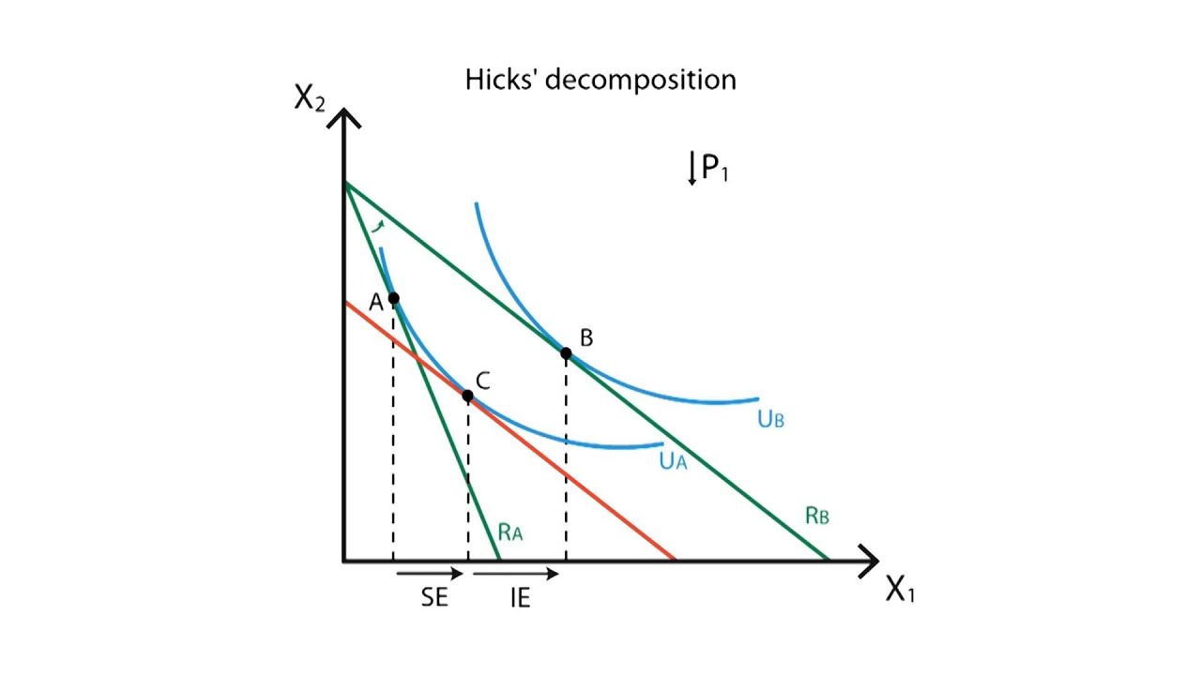
Hicksian decomposition of Price Effect

Slide 12
We can interpret the income and substitution effects using indifference curves. The substitution effect (SE) is the change in consumption that results from being at a point on the same indifference curve with a different marginal rate of substitution. The income effect (IE) is the change in consumption that results from the movement to a higher indifference curve.

Slide 13
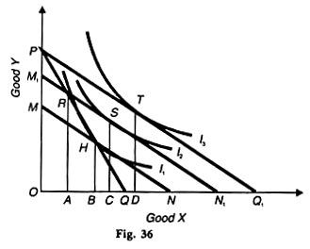
Slutsky Decomposition

Slide 14
PQ is the original budget line where R is the point of equilibrium on indifference curve I₁, at which OA of X and RA of Y are bought by the consumer. Now with the fall in the price of X, the budget line extends to PQ₁ and the consumer moves to point T on the higher indifference curve l₃. The movement from R to T is the price effect which shows that the consumer buys AD more of X, as a result of the fall in its price.
In terms of the Slutsky method, a new budget line M₁ N₁ is drawn parallel to PQ₁ in such a way that the apparent real income of the consumer remains the same even after the fall in the price of X. If M₁ N₁ passes through point R, the consumer has the same money income to buy combination R as he was buying at the old budget line PQ.
But in reality the consumer prefers the combination S to combination R on the budget line M₁N₁, because point S lies on the budget line which is tangent to a higher indifference curve I₂ than point R which lies on a lower indifference curve I₁. The movement from R to S is the Slutsky substitution effect.
As a result, the consumer buys AC more of X and the movement from S to T or CD of X is the income effect.

Slide 15
The Hicksian substitution effect is smaller than the Slutsky substitution effect by BC quantity of X. On the other hand, the Hicksian income effect BD is greater than the Slutsky income effect CD.
The Slutsky theorem is a good approximation to keep real income constant and is superior to Hicks’ method. In the Slutsky method, income can be calculated equal to cost-difference directly by studying market phenomena and behaviour, whereas the Hicksian compensating variation in income is difficult to estimate.
The Slutsky substitution effect provides the consumer greater satisfaction by bringing him on a higher indifference curve, while the Hicksian substitution effect puts him on the initial level of satisfaction on the original indifference curve.

Slide 16
Deriving the demand curve from ICs
Changes in the price of a good alter the consumer’s budget constraint and, therefore, the quantities of the two goods that he chooses to buy. The demand curve for any good reflects these consumption decisions.
A demand curve shows the quantity demanded of a good for any given price. We can view a consumer’s demand curve as a summary of the optimal decisions that arise from his budget constraint and indifference curves.

Slide 18
Sign of the substitution effect
We have seen above that the income effect can be positive or negative, depending on whether the good is a normal good or an inferior good. What about the substitution effect? If the price of a good goes down (refer the following figure), then the change in the demand for the good due to the substitution effect must be nonnegative. That is, if p₁ > p′₁, then we must have x₁₍p′₁,m′) ≥ x₁(p₁,m), so that Δx^{s}₁ ≥ 0.
The proof of this goes as follows. Consider the points on the pivoted budget line where the amount of x₁ consumed is less than at the bundle X. These bundles were all affordable at the old prices (p₁, p₂) but they weren’t purchased. Instead the bundle X was purchased. If the consumer is always choosing the best bundle he can afford, then X must be preferred to all of the bundles on the part of the pivoted line that lies inside the original budget set.
This means that the optimal choice on the pivoted budget line must not be one of the bundles that lies underneath the original budget line. The optimal choice on the pivoted line would have to be either X or some point to the right of X. But this means that the new optimal choice must involve consuming at least as much of good 1 as originally.

Slide 20
Total change in demand
The total change in demand, Δx₁, is the change in demand due to the change in price, holding income constant:
Δx₁= x₁(p′₁,m) − x₁ (p₁,m)
While the substitution effect must always be negative—opposite the change in the price—the income effect can go either way. Thus the total effect may be positive or negative. However, if we have a normal good, then the substitution effect and the income effect work in the same direction.

Slide 21
An increase in price means that demand will go down due to the substitution effect. If the price goes up, it is like a decrease in income, which, for a normal good, means a decrease in demand. Both effects reinforce each other.
On the other hand, if we have an inferior good, it might happen that the income effect outweighs the substitution effect, so that the total change in demand associated with a price increase is actually positive.

Slide 22
Price effect in case of inferior goods
If X is an inferior good, the income effect of a fall in the price of X will be positive because as the real income of the consumer increases, less quantity of X will be demanded. This is so because price and quantity demanded move in the same direction.
On the other hand, the negative substitution effect will increase the quantity demanded of X. The negative substitution effect is stronger than the positive income effect in the case of inferior goods so that the total price effect is negative.

Slide 24
Price effect in case of Giffen good
Economists use the term Giffen good to describe a good that violates the law of demand. Giffen goods are inferior goods for which income effect dominates the substitution effect. Therefore they have demand curves that slope upward.
When the price of potatoes rises, the consumer is poorer. The income effect makes the consumer want to buy less meat and more potatoes. At the same time, because the potatoes have become more expensive relative to meat, the substitution effect makes the consumer want to buy more meat and less potatoes. However, the income effect is so strong that it exceeds the substitution effect. In the end, the consumer responds to the higher price of potatoes by buying less meat and more potatoes.

Slide 26
Some historians suggest that potatoes were a Giffen good during the Irish potato famine of the 19th century. Potatoes were such a large part of people’s diet that when the price of potatoes rose, it had a large income effect. People responded to their reduced living standard by cutting back on the luxury of meat and buying more of the staple food of potatoes.

Slide 27
Law of Demand
Although consumer theory doesn’t restrict how demand changes when price changes or how demand changes when income changes, it does restrict how these two kinds of changes interact. In particular, we have the following.
The Law of Demand: If the demand for a good increases when income increases, then the demand for that good must decrease when its price increases.
This follows directly from the Slutsky equation: if the demand increases when income increases, we have a normal good. And if we have a normal good, then the substitution effect and the income effect reinforce each other, and an increase in price will unambiguously reduce demand.

